Slide 1

ML 101 Course
Arush Garg
AI and Machine Learning Club
Overseas Family School

Slide 2

Course (bit.ly/ML_101)
Introduction to Machine Learning (ML)
Regression
Core ML Concepts
Classification
Decision Trees
Model selection and tuning
Unstructured data: Text
Neural Networks
Unstructured data: Images
Introduction to Deep Learning
Beyond Regression & Classification
Notes:
Hi All, welcome back to ML 101 course. Today we will learn about some of the common techniques used to select the right ML model and how to tune ML models for superior performance.

Slide 3
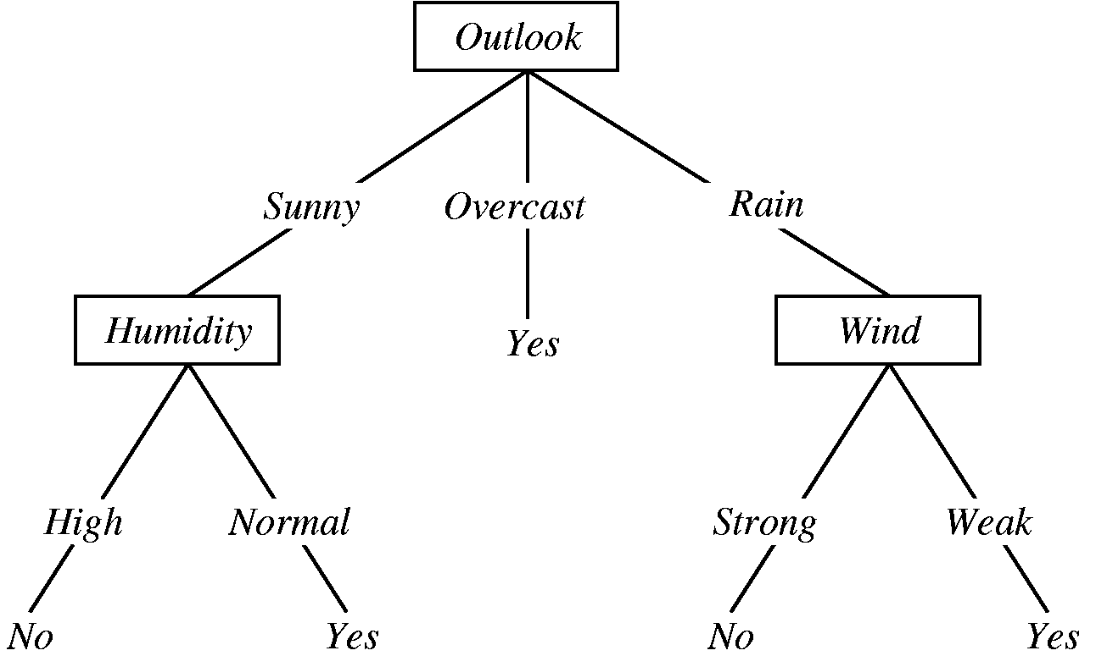
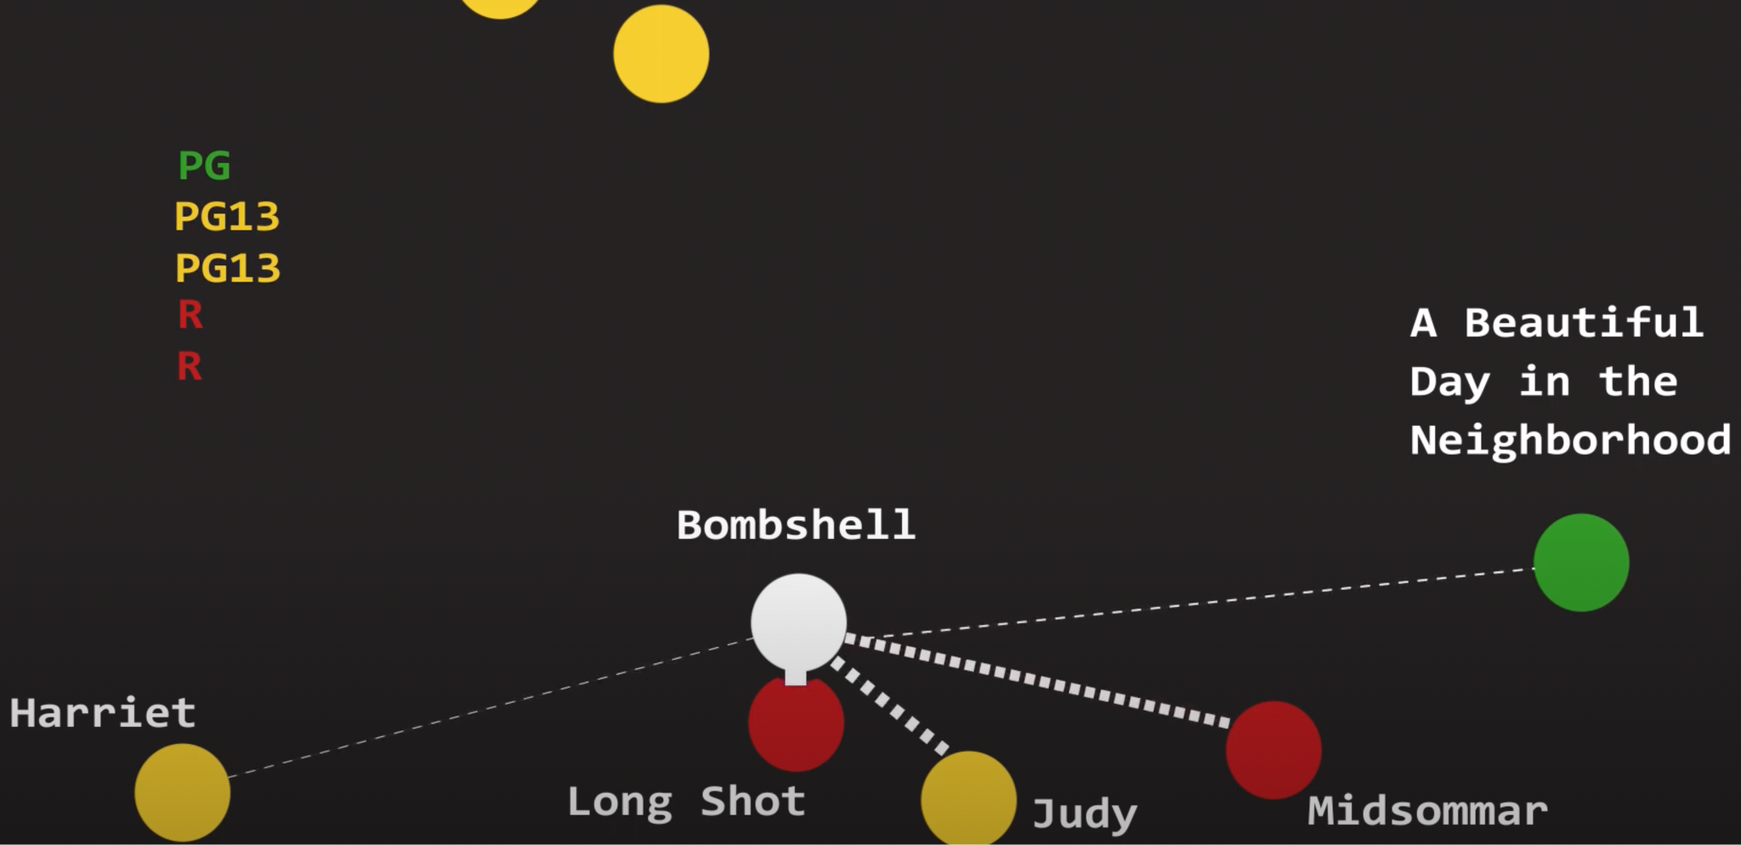
Recap
Supervised Learning
Linear Regression: Regression
Logistic Regression: Classification
Decision Trees: Regression & Classification
KNN: Regression & Classification
Decision Tree
Sequence of nested if-else conditions
Control “tree depth” and “minimum number of data points at leaf node” to avoid over-fitting
Ensemble: Random Forest
Train a group of decision trees, each on a slightly different data (cols & rows)
Take vote (or avg) across trees to make final decision
KNN (K-Nearest Neighbors)
Make prediction based on the label of the K nearest data points in the training set. No “learning” involved.
Sample Decision Tree model to predict Rain
KNN operates on the principle of “you are defined by the company you keep”
Notes:
But first let’s start with a quick recap
So far we have learnt about various Supervised Learning algorithms that can be used for regression and classification problems
In the last lesson we looked at Decision Trees algorithm which learns a sequence of nested if-else conditions from the training data. After that we looked at Random Forest model which is an ensemble of Decision Trees and is a very powerful model that can be used for both classification and regression problems.
We also looked at KNNs, which simply makes future predictions based on the labels of the closest points in the training data. Though it is very simple and does not involve any learning, it can still be a very effective model in many scenarios.
And there are many other models like Naive Bayes, Support Vector Machines, Neural Networks that we haven’t covered yet.

Slide 4
Model Selection for Supervised Learning
Which model to use?
Type of problem:
Classification or Regression
Training Data
Structured (tabular) or Unstructured (text, image, speech, video)
Volume of data / features
Feature <> Label correlation (linear, non-linear)
Model performance / explainability
How important is model explainability?
How well the model performs?
Notes:
Now the obvious next question is: How do we decide which model to use when?
There is no one right answer to this question as many of these models are very versatile and often data preparation turns out to be the bigger differentiator than model selection.
Still there are some general guidelines and process we can follow to find a better model.
As we saw earlier, some models are more suited for regression problems while others are better suited for classification.
Training data can also influence model choice. E.g. often Neural Networks are the model of choice when it comes to unstructured data. Also if the number of features are in 100s, a more sophisticated model like Random Forest will be better than Decision Tree or Logistic Regression. And complex models like Deep Neural Networks often require a lot of training data.
Sometimes there is a trade-off between “how well a model performs” and “how easy is it to explain a model’s decision making process”. E.g. simpler models like LogisticRegression and DecisionTrees are highly explainable but often performs much worse as compared to more opaque models like SVMs and Neural Networks.
Finally of course it also depends on the model performance on that problem. And this is the part we will explore further in this lesson.

Slide 5
Model Parameters vs Hyperparameters
Model Parameters
What model “learns” as part of training. E.g. in case of Linear or Logistic Regression, the “w” and”b” in equation “wx + b” are model parameters
Model Hyperparameters
Hyperparameters are external configuration settings that are not learnt from the data but are set before the training process begins. E.g. “number of trees in a Random Forest”, “K in K-Nearest Neighbors”, “max-depth” in Decision Tree”
Notes:
But before that let’s understand what are Hyperparameters as “improving model performance” often includes “hyperparameter tuning”.
The model training we have done so far is all about “parameter tuning”. E.g. when we run the Gradient Descent algorithm to find “w” & “b” such that cost function is minimized, that’s called parameter tuning.
Whereas “hyperparameters” are external model settings that are not learnt from training data. E.g. how many trees we use in a Random Forest, the choice of “k” in K Nearest Neighbors
As these settings have a significant impact on the performance of the ML model, it is important to know the do’s & don’ts when it comes to tuning hyperparameters

Slide 6
Model Tuning: Overfitting the test set
What happens when the model doesn’t perform well on “test set”?
We will be tempted to analyse the “errors” and update our model training steps in order to address those errors.
And we might repeat this process multiple times (Train => Test => Analyse)
This is a concern as we might end up over-fitting the model to “Test set”
Ideally we should treat “test set” as opaque, i.e. do not analyze model’s performance on the“test set”. But then how do we iterate?
Notes:
When training a model we would like to make sure it learns properly.
Therefore when a model does not perform well on test data, we would like to analyse the mistakes it makes and update our training steps to help it learn better. And we will be tempted to do it repeatedly till we are satisfied by the model’s performance on the test set.
(click)
But this is a common beginners mistake. Even if we don’t use “test data” as part of training, this approach might make the model over-fit the “test data” and its performance on future unseen data might be much worse.
So if we can use “test data” to analyze and improve model performance, what do we do?

Slide 7
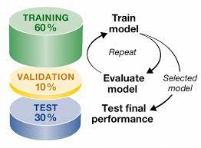
Introducing “Validation Set”
Instead of dividing “data set” into two parts(Train and Test), we divide it into three parts (Train, Validation and Test).
Validation set is used to analyse model errors and tune the model till we are satisfied with the performance before evaluating the model on test set.
Model’s final metrics are still reported based on its performance on Test set.
Notes:
A natural choice would be to divide the “data set” into 3 parts: train, validation & test
Validation set is used to analyse model performance and iterate. Only once we are satisfied with model’s performance on the “validation set” we confirm if the performance holds good on the test set as well or not.
This is a reasonable approach can be a good starting point.

Slide 8
Limitations of 3-split (Train, Validation, Test) approach
If our test and validation sets are large (e.g. ~30% each) that makes our training set to be very small. We might end up sacrificing model quality which would be unacceptable.
If our test and validation sets are small (e.g. ~10%) the sets might not be good representation of “unseen data” and the performance metrics on these sets might be unreliable
This might not be a concern when training on “large datasets” but that is often not the case.
Notes:
But this approach has some limitations.
To be effective, the test & validation sets have to be large enough to be representative, which reduces the available training data size significantly, often compromising model’s performance.
On the other hand, very small test & validation sets might lose their purpose if they are not able to represent the “unseen data” properly.

Slide 9

Introduction to “k-Fold Cross Validation”
Divide the training data into “k” folds
k = 5 in the image on the left
Train “k” different models. While training each model, treat one of the fold as “validation set” (blue) and remaining “k-1” folds as “training set” (green).
For each model you will get the “performance metrics” on the validation set. For “k” models you will get “k” performance numbers. This gives us a:
“range” of model performance
allows us to analyze the errors & make changes to the model without looking at test data
Once you are satisfied with the model tuning, you can train a new model on the “entire training data” and evaluate it on the “test data” to get final performance numbers.
Split Training Data
Model 1
Model 2
Model 3
Model 4
Model 5
Image Source
Notes:
A common approach to work-around this limitation is called “k-Fold Cross Validation”.
We first divide the training data into “k” folds, k is 5 in this example.
Then we train a model using “k-1” i.e. 4 folds as training data and 1 fold as validation set. But we don’t stop here. We keep picking a different fold as “validation set” and training a different model using remaining “k-1” folds as training data.
This way we end up with “k” trained models and a range of performance metrics on the “k” validation sets”. We can analyze the errors across these sets, change our model settings and run the entire process again, till we are satisfied with the model’s performance.
Then we can use the best model settings to train a fresh model on entire training data (all “k” folds) and evaluate its performance on the test data

Slide 10
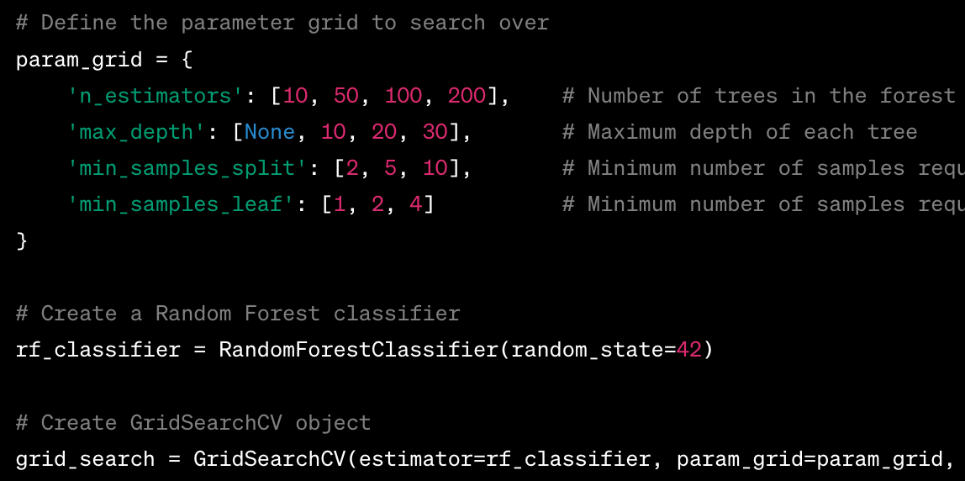
Hyperparameter Tuning: GridSearchCV (CV stands for Cross Validation)
= 4 options
= 4 options
= 3 options
= 3 options
4*4*3*3 = 144 options
If k = 5 for CV,
144*5 = 720 models
Helps pick the best hyperparameters without using “test set”
Hyperparameters
Notes:
Grid Search Cross Validation is a technique commonly used for Hyperparameter tuning using k-fold Cross Validation
As we discussed earlier, there are often many options for the Hyperparameters and it is be very tiring and time-consuming to try every single option.
GridSearchCV helps simplify this process. You start by providing a list of hyperparameter options that you want to explore. E.g. in this code example we have 4 different Hyperparameters for RandomForestClassifier and each hyperparameter has 3 to 4 possible options
GridSearchCV will end up evaluating every single hyperparameter combination, i.e. 144 options
And let’s say we pick k = 5 for Cross Validation, GridSearchCV will train 5 models for each of the 144 options, hence total 720 different RandomForestClassifier models.
This will help us find what combination of hyperparameters gives best performance based on CrossValidation sets and this hyperparameter combination can then be used to train the model on entire training set.

Slide 11

Hands-on Exercises
Lesson 6 / CarClassification.ipynb
https://bit.ly/ML_101
Notes:
This week’s exercise looks at classifying a car as unacceptable, acceptable, good or very good. This problem is tackled using three models: Random Forest, Decision Tree and KNN, whose parameters are fine-tuned using GridSearch.

Slide 12
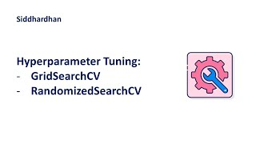

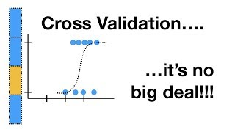
Further Reading / Watching / Doing
Practice notebook
WineQuality.ipynb
Siddhardhan on YouTube
https://www.kaggle.com/code/shreayan98c/hyperparameter-tuning-tutorial
https://neptune.ai/blog/improving-ml-model-performance
StatQuest with Josh Starmer
Notes:
To practise more with GridSearch, check out the problem posed by the problem.md file. The task is to judge the quality of Wine between 0 and 10, based on the results of a chemical analysis. You can try Grid Searching with Classification and Regression models for this problem.
To learn more about Hyperparameter tuning and Cross Validation, check out these videos. There are also some tutorials on Kaggle for this topic.

Slide 13

Agenda for next class
Unstructured Data (text)
How to train a model using unstructured data like text?
E.g. whether an email is a spam or not
How will we convert “words” to “numbers” to be used in a mathematical equation?
Techniques used here are foundational for training a LLM (large language model)

